Slide 1
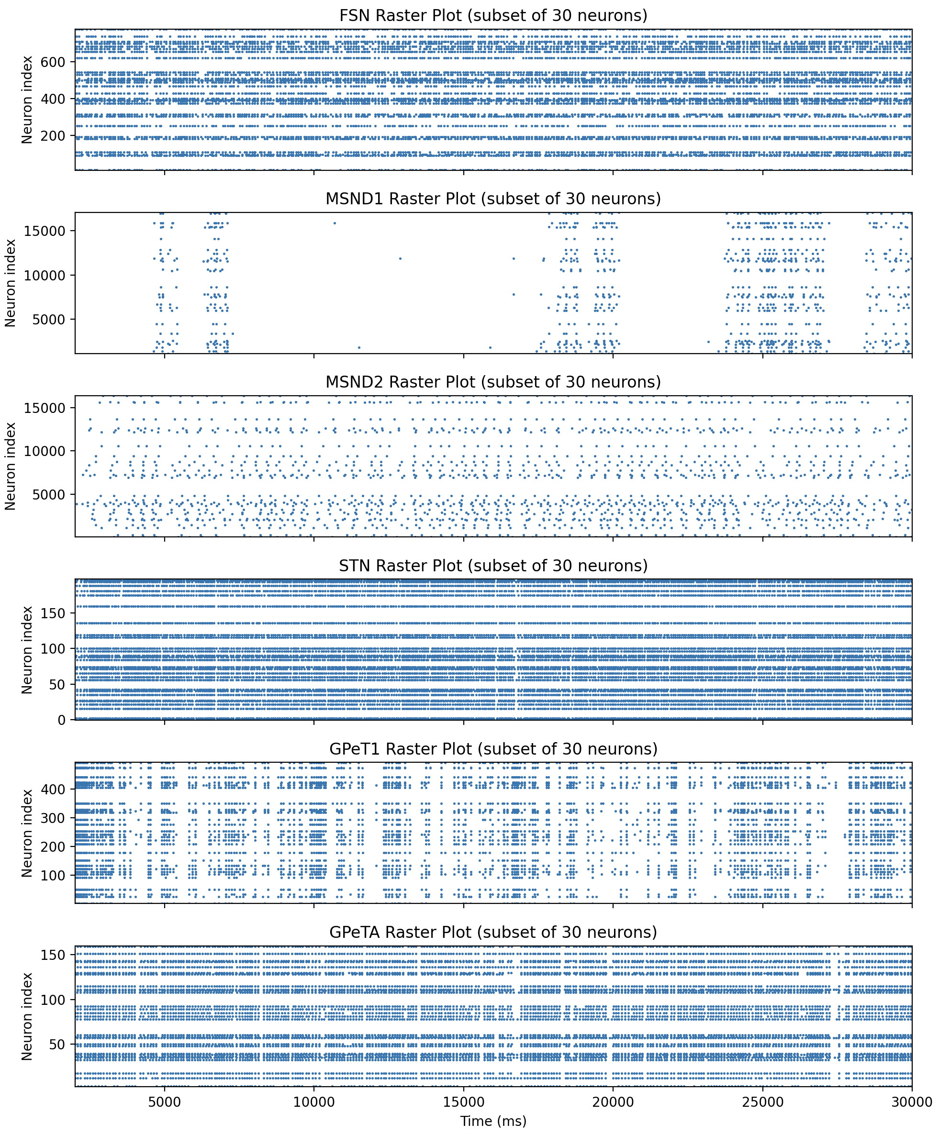
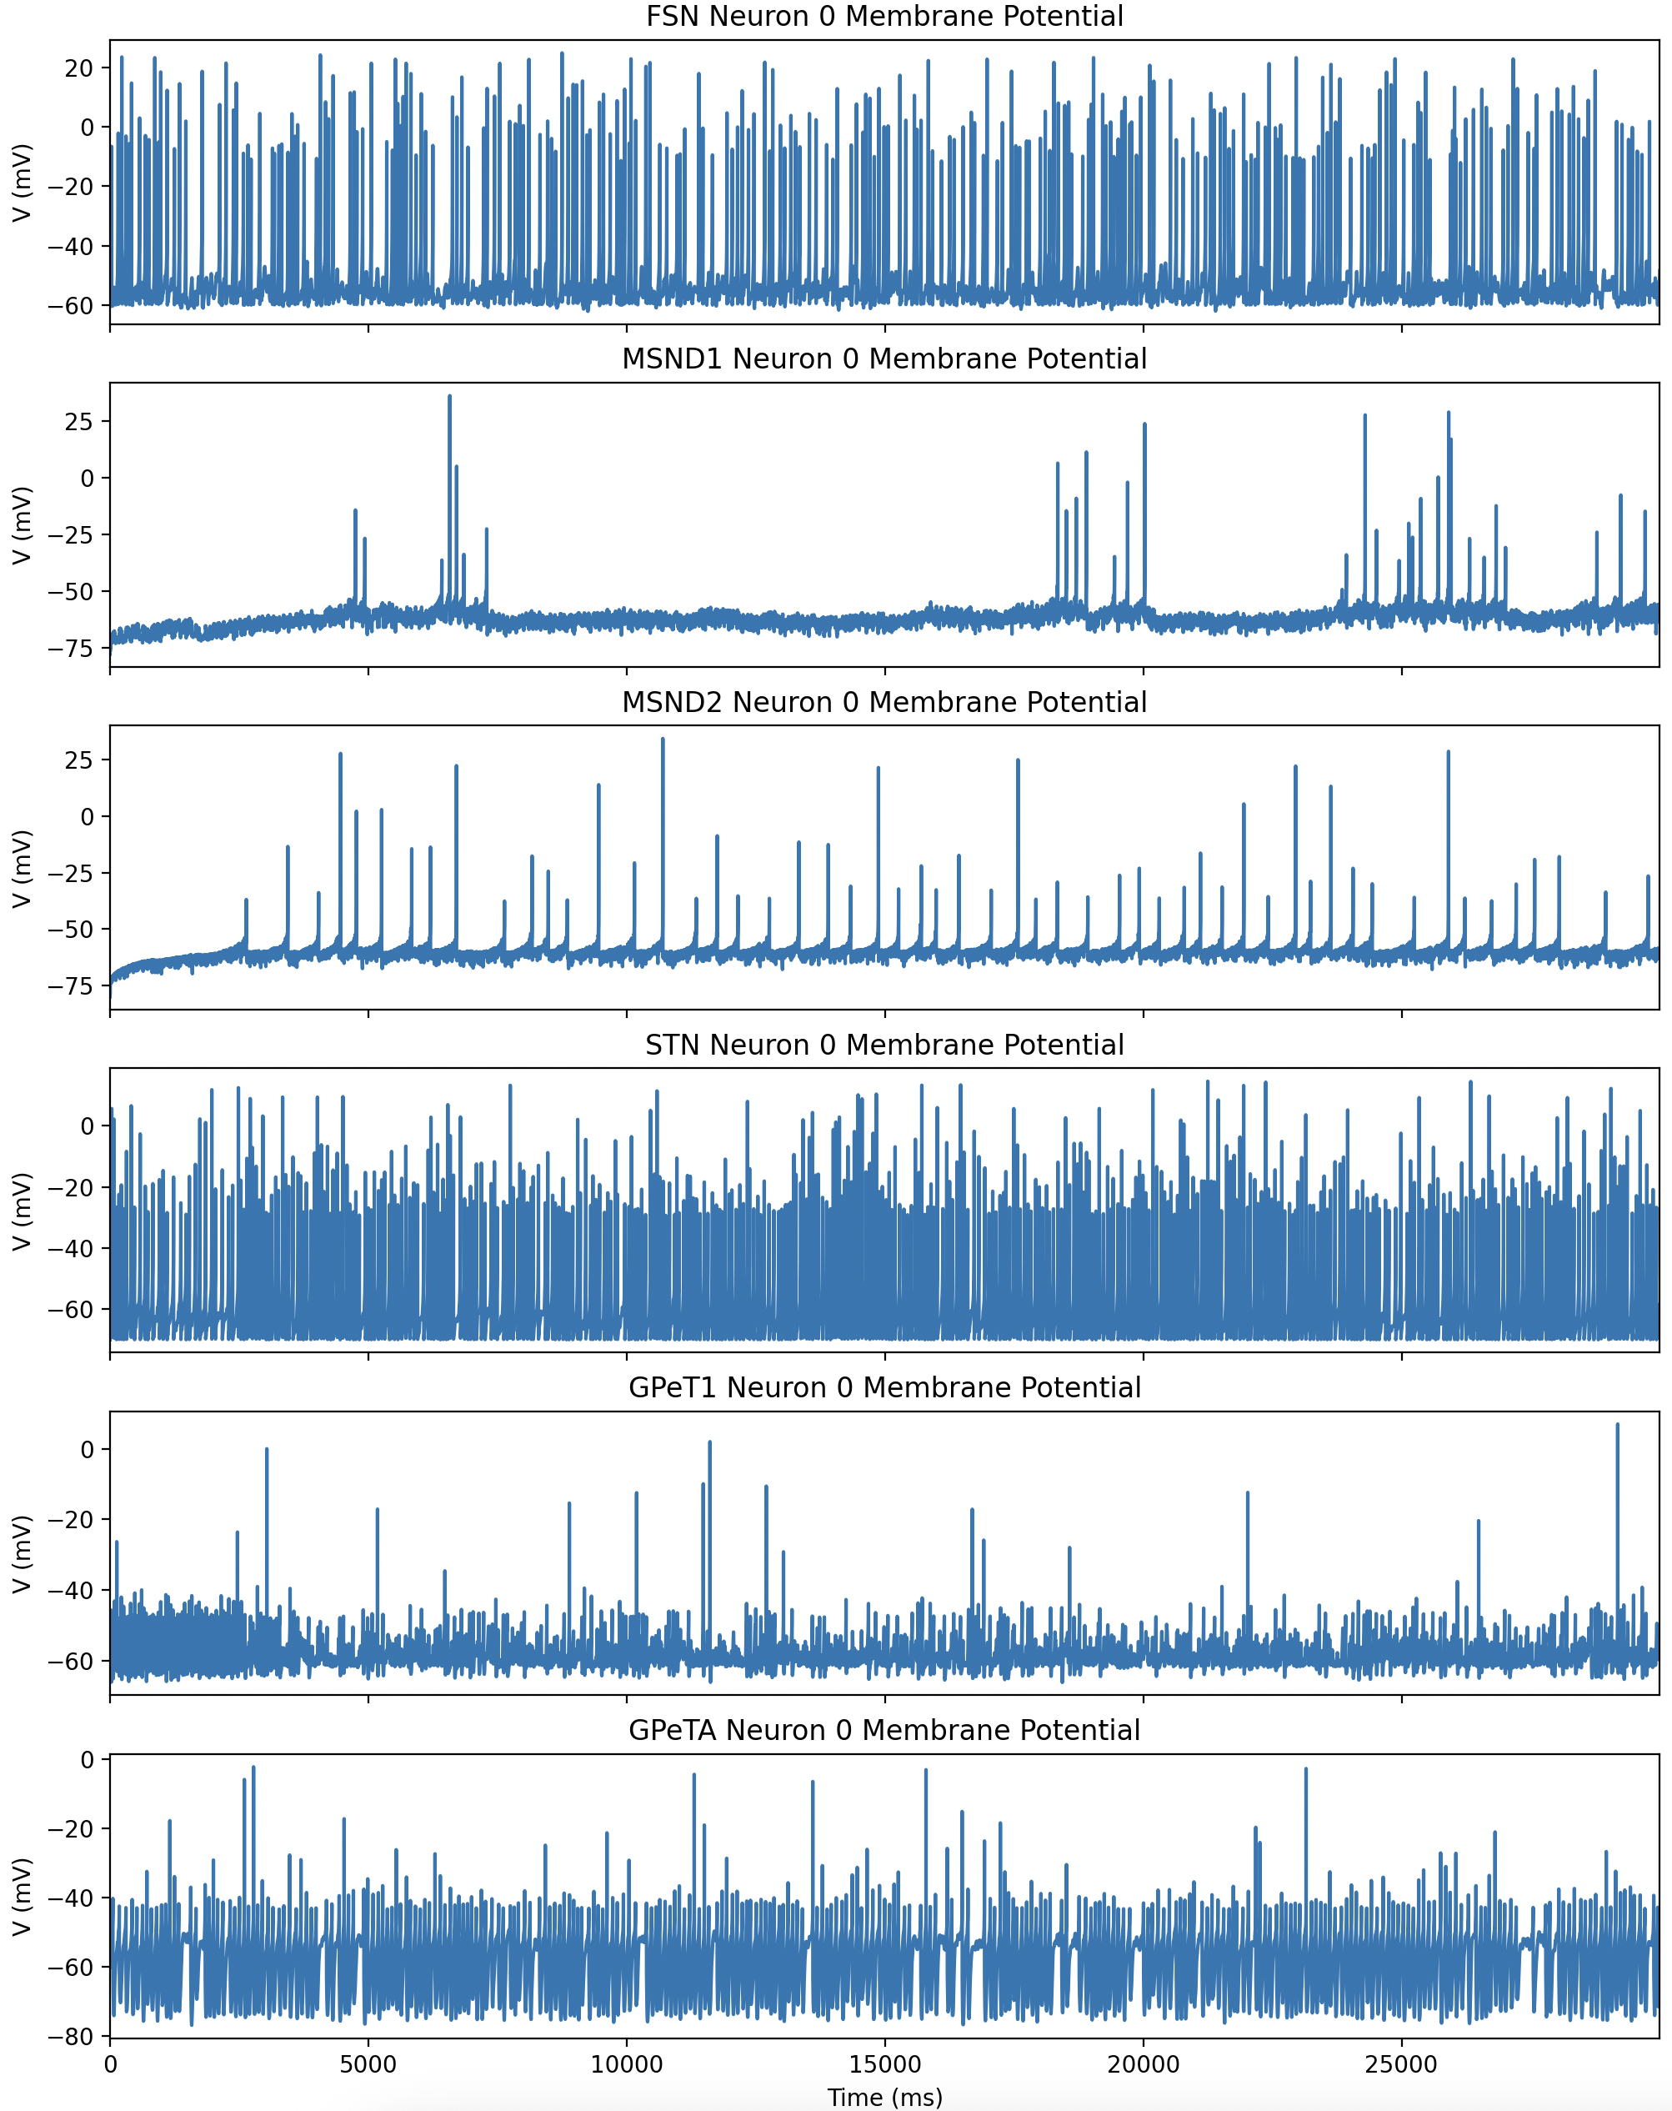
전체 뉴런에 대한 raster plot
Stimulus 부여하지 않음
Neuron Model Test
normal
Notes:
[FSN] Mean Firing Rates (2000–30000ms): 10.33 Hz
[STN] Mean Firing Rates (2000–30000ms): 13.92 Hz
[MSND1] Mean Firing Rates (2000–30000ms): 0.28 Hz
[MSND2] Mean Firing Rates (2000–30000ms): 1.93 Hz
[GPeT1] Mean Firing Rates (2000–30000ms): 4.83 Hz
[GPeTA] Mean Firing Rates (2000–30000ms): 9.29 Hz

Slide 2
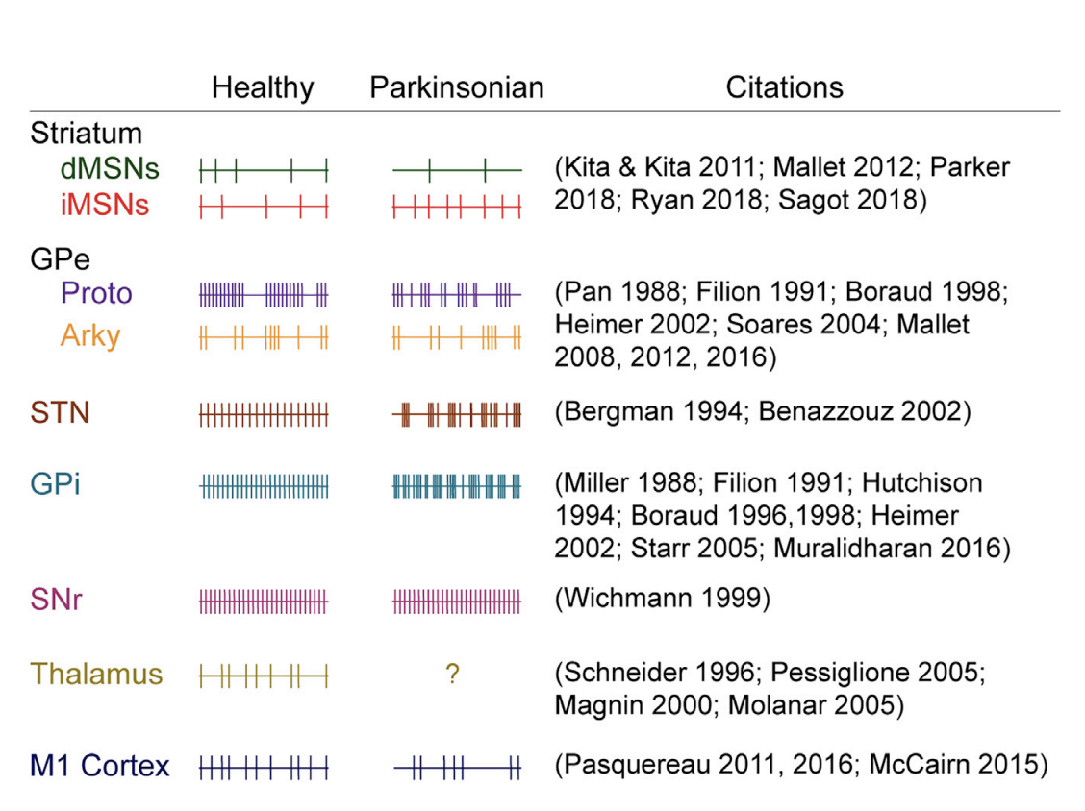
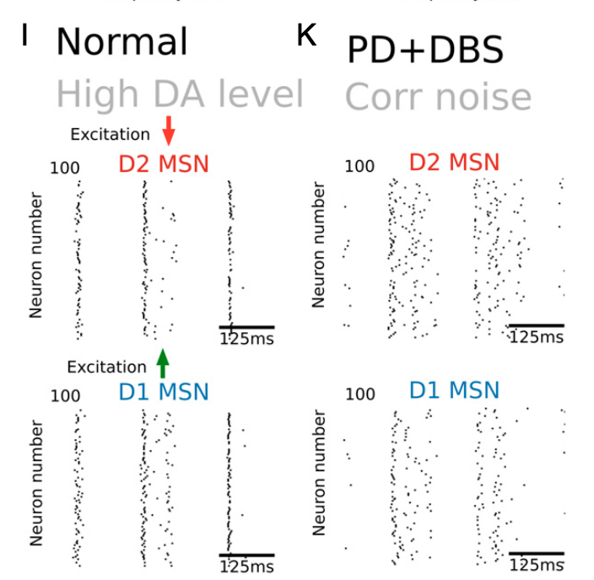
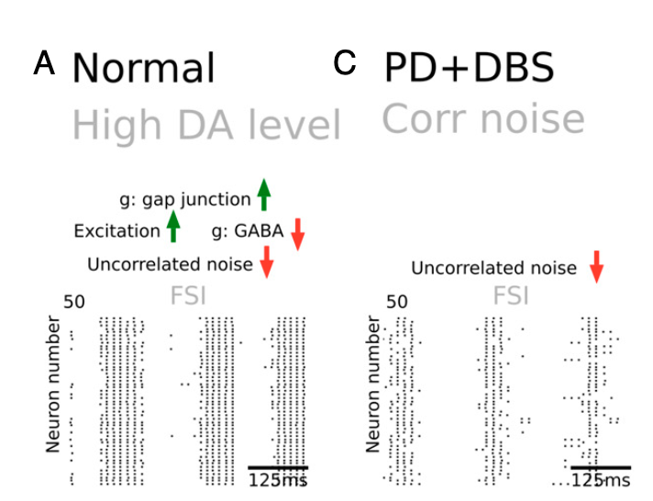
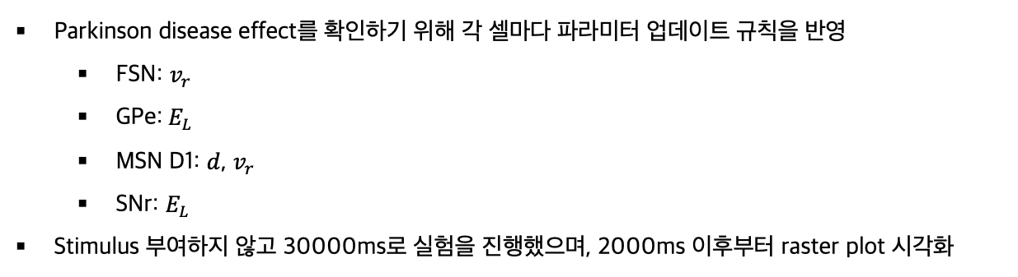
Neuron Model Test
D1 감소, d2 증가s
Parkinson disease effect를 확인하기 위해 각 셀마다 파라미터 업데이트 규칙을 반영
FSN: $v_{r}$
GPe: $E_{L}$
MSN D1: $d$, $v_{r}$
SNr: $E_{L}$
Stimulus 부여하지 않고 30000ms로 실험을 진행했으며, 2000ms 이후부터 raster plot 시각화
Notes:
Deep brain stimulation in the subthalamic nucleus for
Parkinson’s disease can restore dynamics of striatal networks
Circuit Mechanisms of Parkinson’s Disease

Slide 3
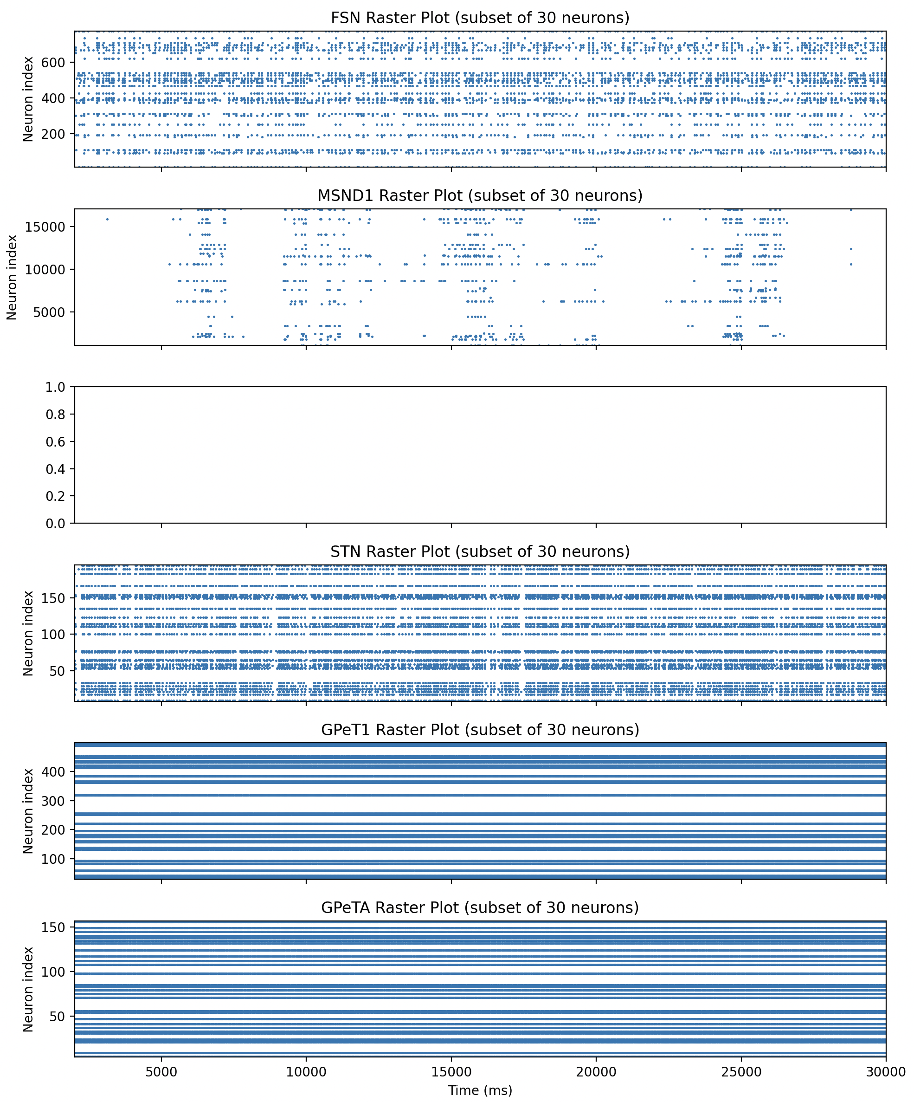
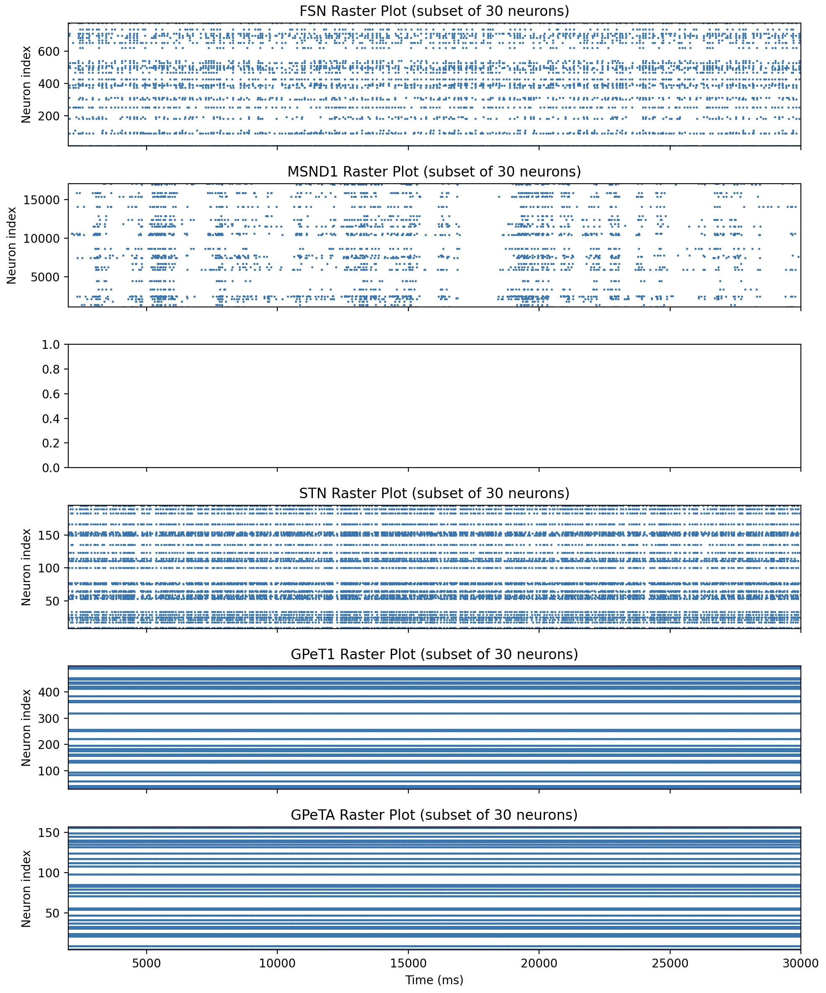
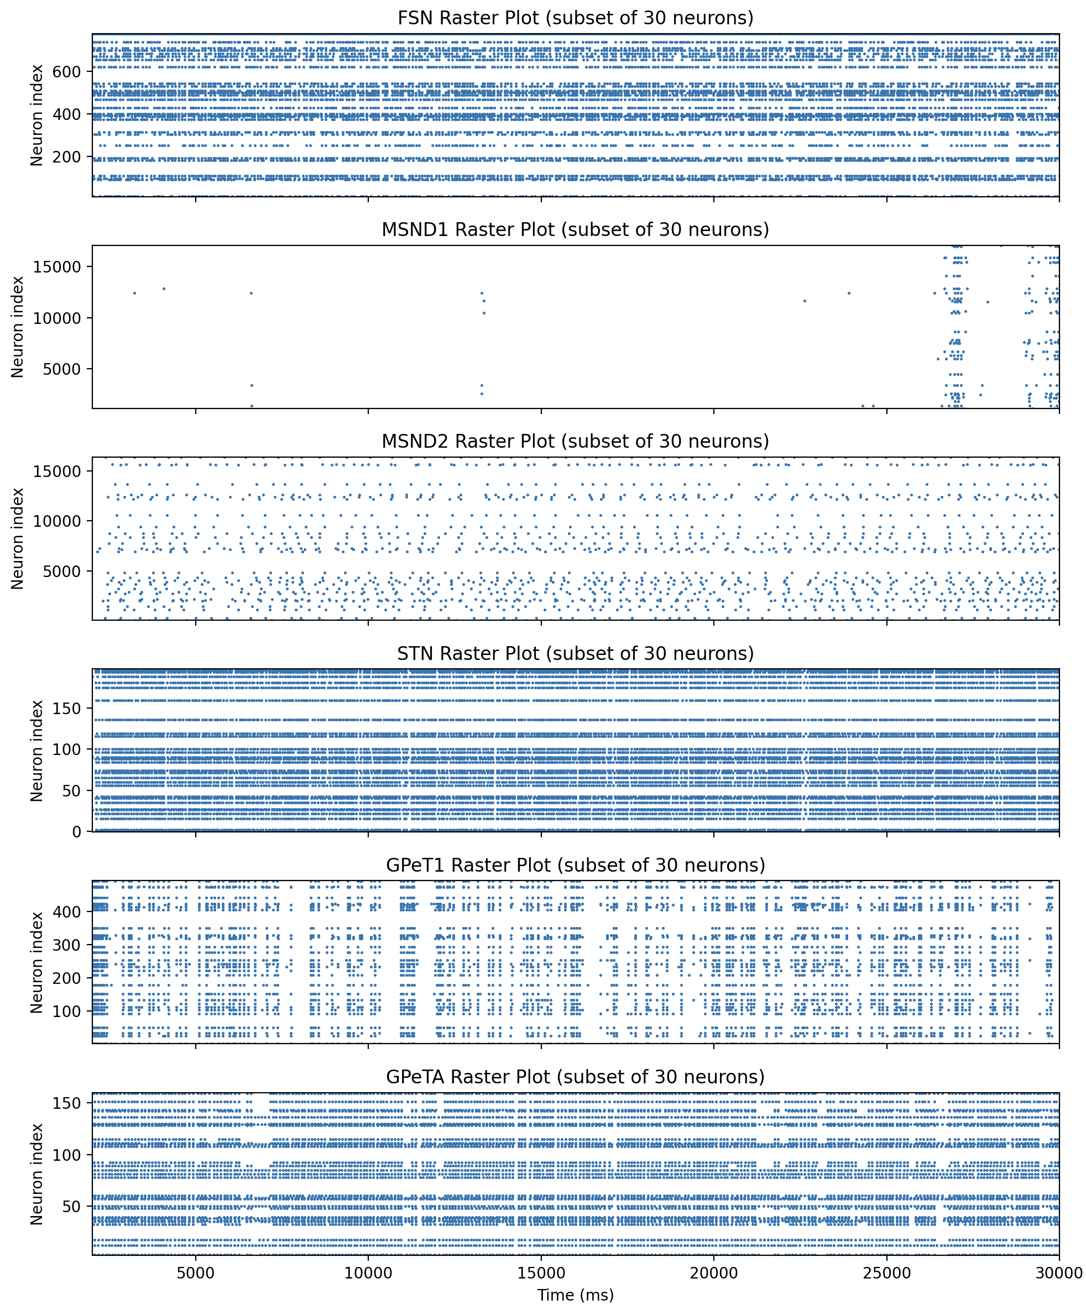
Gpe 이름 변경
Neuron Model Test
pd
normal
Notes:
[FSN] Mean Firing Rates (2000–30000ms): 10.33 Hz
[STN] Mean Firing Rates (2000–30000ms): 13.92 Hz
[MSND1] Mean Firing Rates (2000–30000ms): 0.28 Hz
[MSND2] Mean Firing Rates (2000–30000ms): 1.93 Hz
[GPeT1] Mean Firing Rates (2000–30000ms): 4.83 Hz
[GPeTA] Mean Firing Rates (2000–30000ms): 9.29 Hz
[FSN] Mean Firing Rates (2000–30000ms): 4.91 Hz
[STN] Mean Firing Rates (2000–30000ms): 11.02 Hz
[MSND1] Mean Firing Rates (2000–30000ms): 0.79 Hz
No spikes recorded for MSND2
[GPeT1] Mean Firing Rates (2000–30000ms): 36.61 Hz
[GPeTA] Mean Firing Rates (2000–30000ms): 30.93 Hz

Slide 4
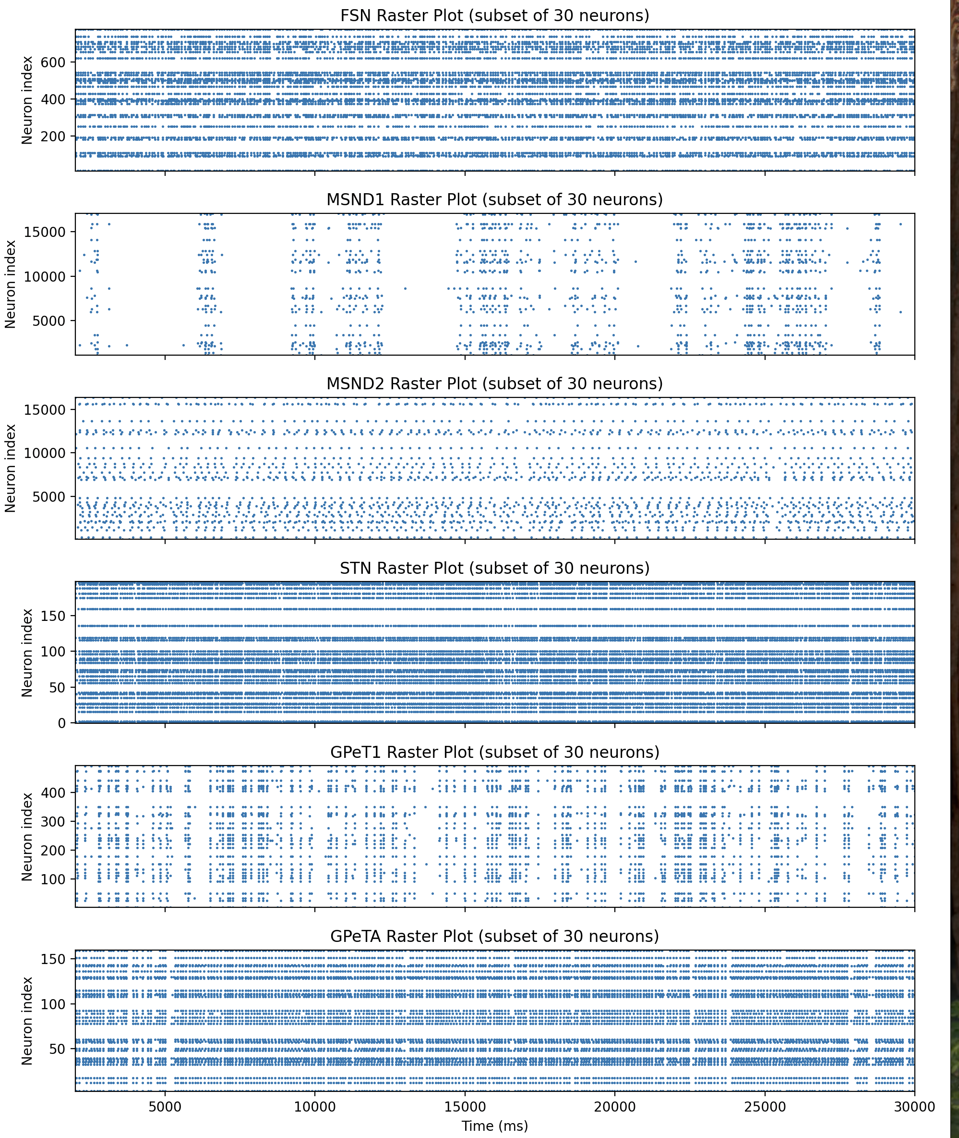
Neuron Model Test
pd
normal

Slide 5
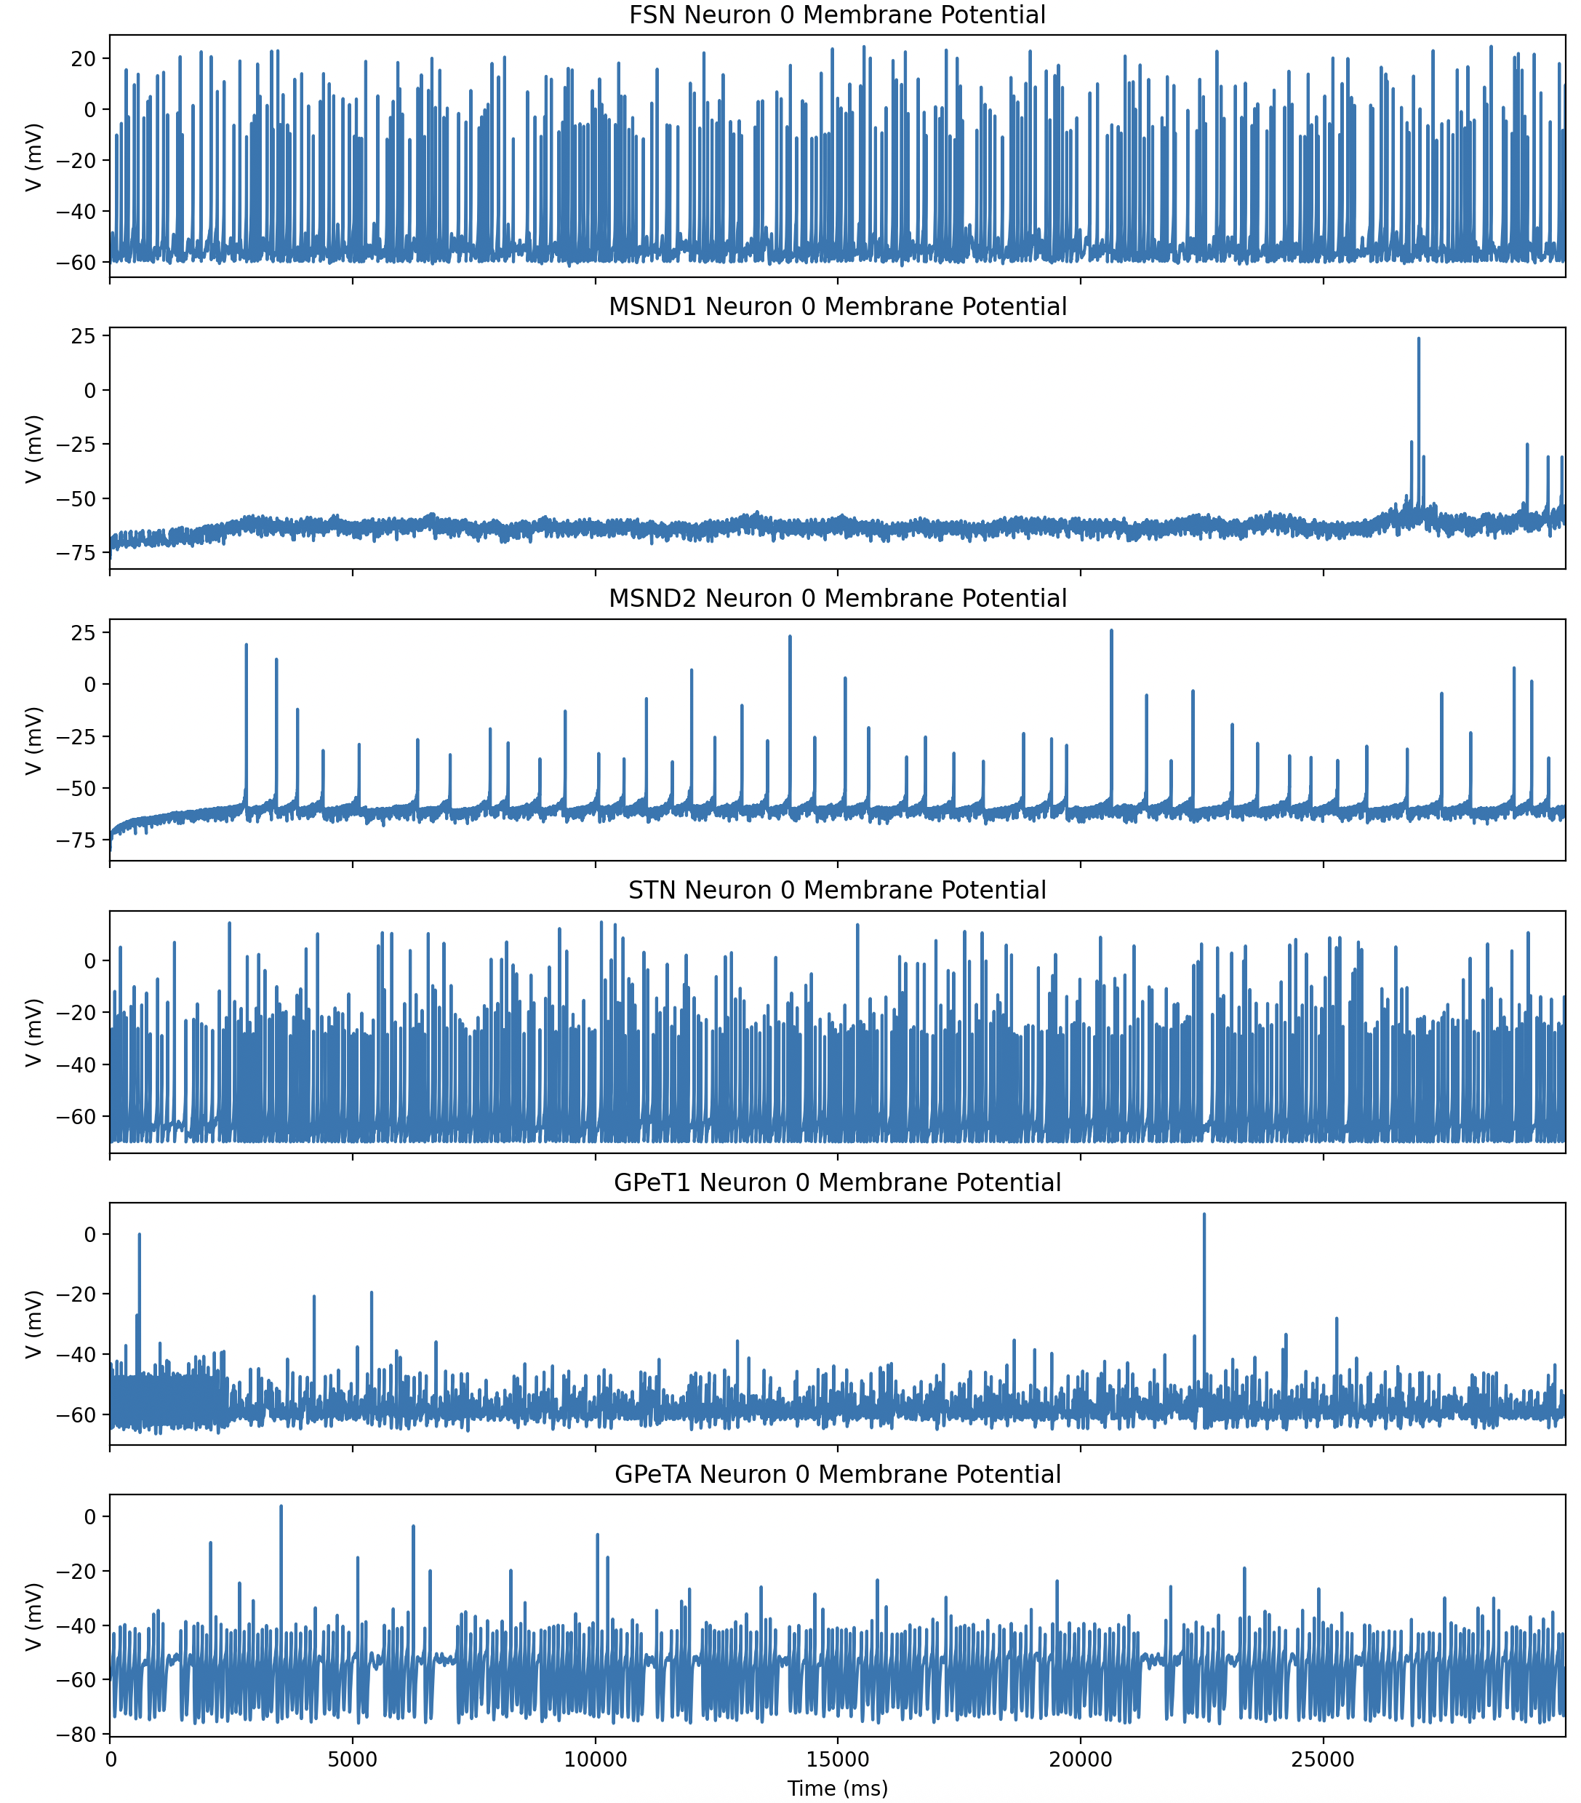
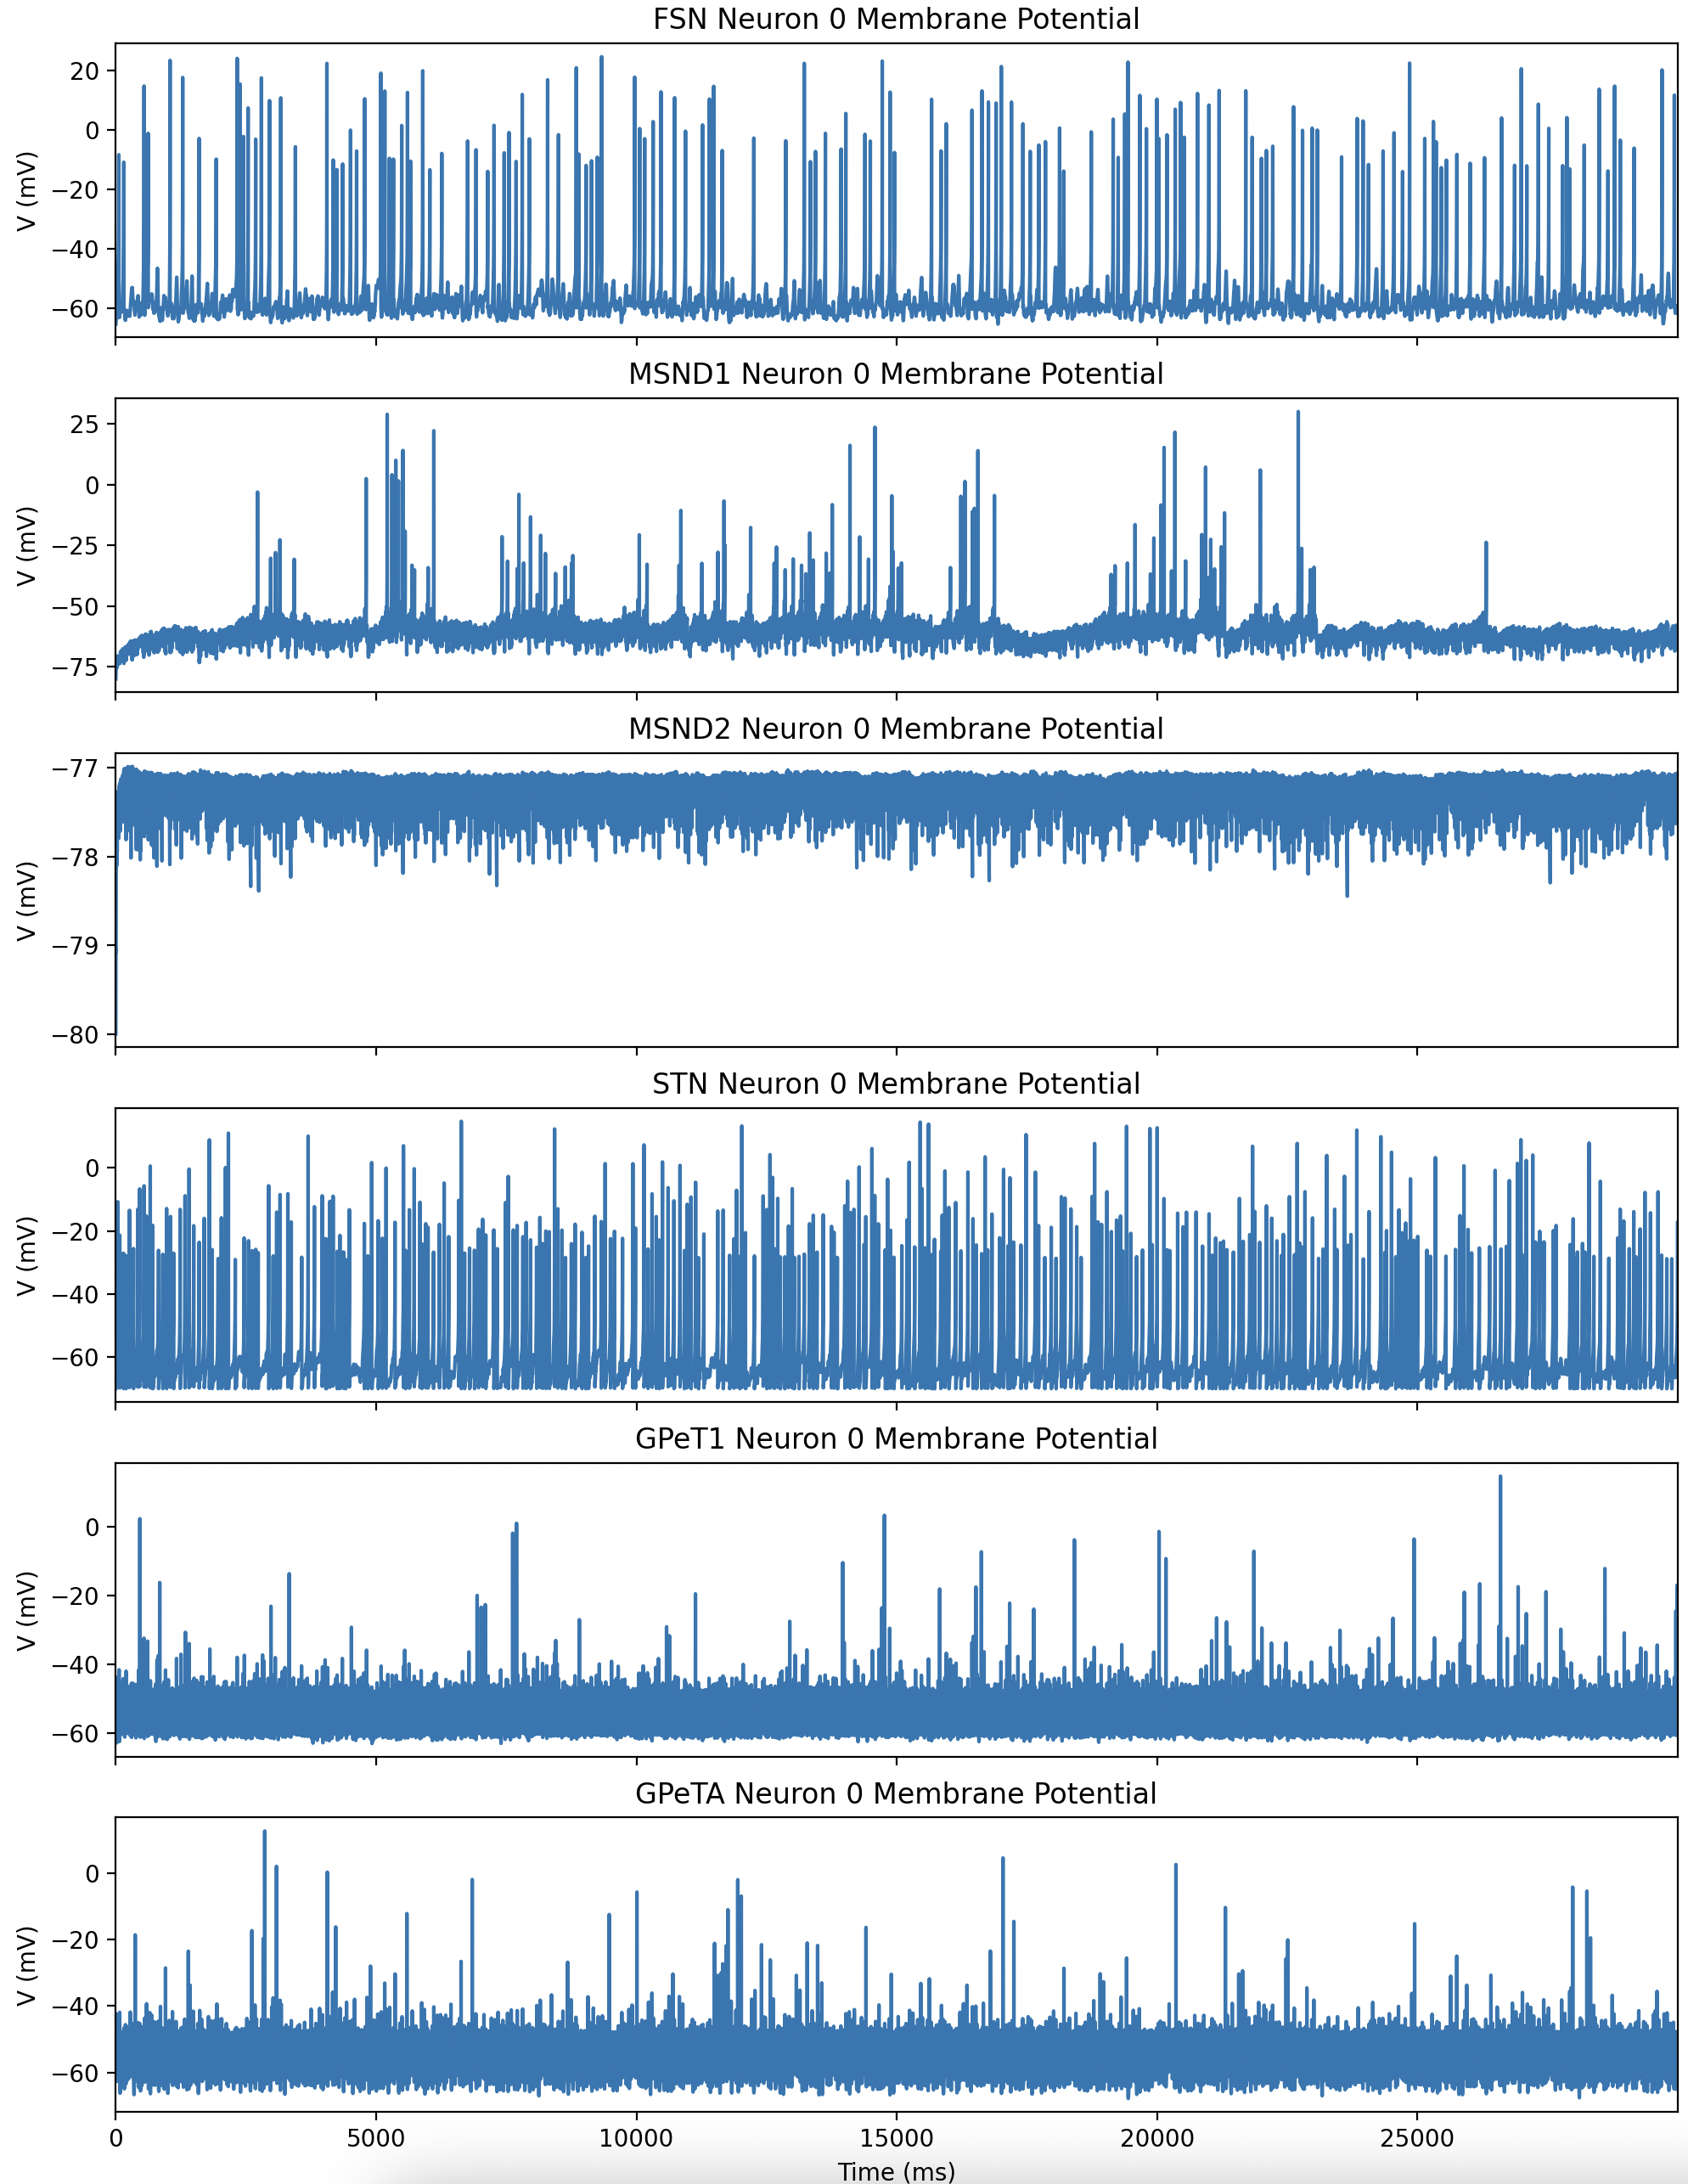
Neuron Model Test
normal
pd

